Slide 1

Classification, Reserve & RQO determination of water resources in the Mvoti to Umzimkulu Water Management Area
RECAP OF SCENARIOS
Pieter van Rooyen
WRP
16 September 2015
PRESENTATION TITLE
Presented by:
Name Surname
Directorate
Date

Slide 2
Mvoti Study integrated steps
1: Delineate units of analysis and describe the status quo
2: Initiation of stakeholder process and catchment visioning
3: Quantify EWRs
7: Gazette class configuration
4: Identification and evaluation of scenarios within IWRM
6: Resource Quality Objectives (EcoSpecs & water quality (user))
5: Draft Management Classes
Scenario Evaluation, MC determination
2

Slide 3
Layout of Presentation
Scenarios, evaluation and comparison (recap)
Waste water management scenarios – Why is it relevant?
Extent of wastewater generation in the three estuary IUA clusters (current and future)
Alternative Wastewater Management Measures
Formulation of scenarios for analysis

Slide 4
What are scenarios used for? (recap)
Different levels of water use and protection are evaluated with the aim to find a preferred balanced scenario.
Water Resource Classification is the process to evaluate and recommend what that balance scenario entails.

Slide 5
Overview of Scenarios
Mvoti River System Scenarios:
  EWR releases, Isithundu & Imvutshane dams.
Mkomazi River System:
  EWR releases, Smithfield & Ngwadini dam, Operating Releases.
uMngeni River System:
  Mooi-Mgeni Scheme, Re-use: Darvill & Ethekwini
uMdloti / uThongathi River System:
  Hazelmere Dam Raising, Indirect Re-use, eThekwini Wastewater Disposal Options.
River system (estuaries) with wastewater discharges
  See subsequent slides

Slide 6
Wastewater management scenarios – Why is it relevant?
Typical ecological implication on estuary health:
  Change in function (open and close characteristics) of estuary due to continuous base flow.
  Elevated nutrient load causing eutrophication, resulting in depletion of dissolved oxygen concentrations, inhibiting organism health.
Increasing need for waterborne sanitation services requiring treatment and disposal.

Slide 7
Classification Perspective
Classification entails finding an appropriate balance between the protection of the ecology , on the one hand, and the implication on water use, on the other.
  Balance derived by considering and evaluation scenarios.
DWS study identified the need to assess alternative wastewater disposal options in context of the implication on the ecological health of the affected estuaries.

Slide 8
Information sources to define the extent of wastewater discharges and scenarios
Southern Cluster (Ugu DM)
  Green Drop GIS Data – location
  Current discharge volumes (Green Drop)
  Ulitmate dischage volumes (ISP,WSDP, DWS Studies)
Northern Cluster (iLembe DM)
  GIS data – location of treatment plants
  Current discharge volumes (Green Drop)
  Ulitmate dischage volumes (ISP,WSDP, DWS Studies, Siza Water)
Central Cluster (eThekwini MM):
  GIS data – location of treatment plants.
  Current discharge volumes and quality.
  Spatial Development Plan with associated Ultimate Wastewater Discharge Scenario.

Slide 9
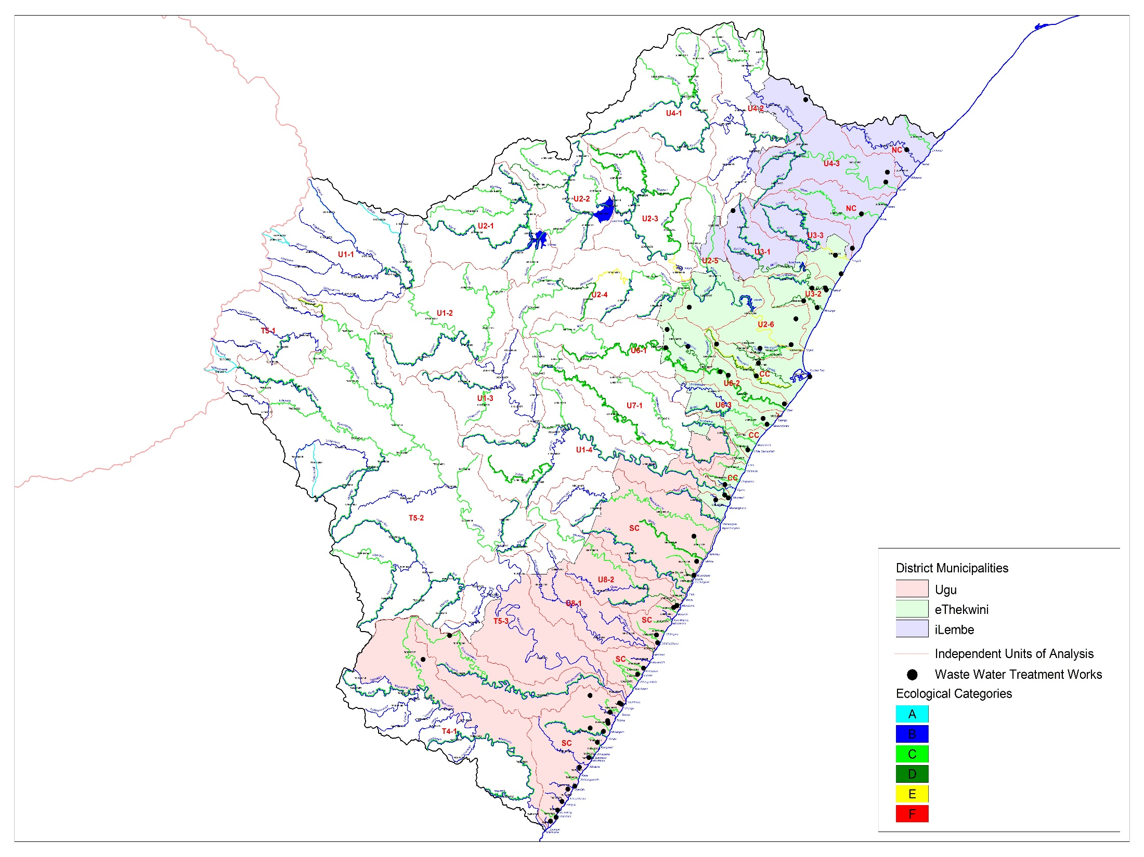
Central Cluster (CC)
16 Estuaries
24 wastewater treatment plants
Discharge (Ml/day):
  Current: 440
  Future: 1 188
NorthernCluster (NC)
7 Estuaries
7 wastewater treatment plants
Discharge (Ml/day):
  Current: 25.8
  Future: 63.9
Southern Cluster (SC)
41 Estuaries
21 wastewater treatment plants
Discharge (Ml/day):
  Current: 26.7
  Future: 44.9
Notes:
Desktop vir riviere.

Slide 10
Alternative Wastewater Management Measures
Identified the following types of alternative options:
  Additional treatment processes to reduce the nutrient pollution load discharged.
  Transferring treated waste from a sensitive estuary to a different river and estuary system that is able to assimilate the additional load.
  Discharge of wastewater through sea outfall works - discharges to estuaries are reduced or eliminated.
  Re-use of treated wastewater, both direct and indirect.

Slide 11
Primary Scenarios
Label | Scenario Description
A | Ecological protection is priority (minimum discharge to estuaries)
B | Minimum costs scenario (highest flow through estuaries)
C | Current and short term (5 year) flow discharged into river systems, remainder through alternative means.
D | Current and medium term (10 year) flow discharged into river systems, remainder through alternative means.
E | Indirect re-use (consider volume and practicalities) Remainder According to Scenario C.
F | Direct re-use (consider volume and practicalities) Remainder According to Scenario C.
X | Alternative scenarios (combinations of alternative)

Slide 12
Scenario Definitions (1 of 2)
Sc | Scenario Description | Comment
Ai | Ecological protection is priority (minimum discharge to estuaries) | Northern and Southern Cluster: 30% of future ww flow to estuary, remainder through marine outfall.
Aii | Ecological protection is priority (minimum discharge to estuaries) | Northern and Southern Cluster: Discharge current capacity, remainder disposal through marine outfall.
Aiii | Ecological protection is priority (minimum discharge to estuaries) | All Clusters: Discharge current capacity, remainder disposal through marine outfall.
Av | Ecological protection is priority (minimum discharge to estuaries) | As Ai: Option for Central Cluster (discharge to iSipingo).
Bi | Minimum costs scenario (highest flow through estuaries) | Options for Central Cluster: Low nutrient discharge from (high costs)
Bii | Minimum costs scenario (highest flow through estuaries) | As Bi: Different infrastructure options for Central Cluster (lower costs). uMkhomazi estuary received 50Ml/day WW flow .
Biii | Minimum costs scenario (highest flow through estuaries) | As Bi: Current treatment (high) nutrient discharge (low costs).

Slide 13
Scenario Definitions (2 of 2)
Sc | Scenario Description | Comment
C | Current and short term (5 year) flow discharged into river systems, remainder through marine outfall. | Northern and Southern Clusters: Short term increases in discharges. Central Cluster: Short term increases in discharges with low nutrient discharge (high costs)
Ci | Current and short term (5 year) flow discharged into river systems, remainder through marine outfall. | Northern and Southern Clusters: Short term increases in discharges. Central Cluster: As C: Current treatment (high) nutrient discharge (low costs)
D | Current and medium term (10 year) flow discharged into river systems, remainder through marine outfall. | Northern and Southern Clusters: Medium term increases in discharges. Central Cluster: Low nutrient discharge (high costs)
Di | Current and medium term (10 year) flow discharged into river systems, remainder through marine outfall. | Northern and Southern Clusters: Medium term increases in discharges. Central Cluster: As D: Current treatment (high) nutrient discharge WWTW (low costs)
E | Indirect re-use (consider volume and practicalities) Remainder According to Scenario C. | Northern and Southern Clusters: Reuse 50% if future ww flow. Central Cluster: Reuse via Hazelmere Dam.
F | Direct re-use (consider volume and practicalities) Remainder According to Scenario C. | Northern and Southern Clusters: Reuse 50% if future ww flow. Central Cluster: High level of treatment (high operating costs), supply into distribution system.

Slide 14
Identified Option in the Central Cluster
Identified 27 primary options related to each river system
  Sub-options: Relating to levels of treatment and phasing.
  Eliminate 12 options through inspection
  Prepare concept design and costing for 15 primary options.
    (Capital and O&M costs)
Indirect reuse (Hazelmere Dam)
Information obtained from eThekwini Wastewater Disposal Study

Slide 15
Wastewater Management Options’ Cost Estimates
Obtained costs from eThekwini’s study for specific wastewater disposal options.
Combined disposal options to form scenarios.
Ugu and Illembe: Determined rations of CAPEX (R/m³) and OPEX (R per annum /m³) and apply to relevant volumes for Ugu and Illembe scenarios.
Cost results are input to macro-economic model. (see agenda Item 6.5 presentation)

Slide 16
  QUESTIONS FOR CLARIFICATION

